Slide 1
QEP Implementation
Fall 2023
Entering Year 4 of Implementation

Slide 2
QEP Goal & Student Learning Outcomes
The goal of this QEP is to improve students’ problem-solving skills through Quantitative Literacy.
Student Learning Outcomes:
1. Students will demonstrate improved academic problem solving by applying Quantitative Literacy skills across the curriculum.
2. Students will demonstrate ability to solve real would problems using inductive and deductive reasoning.

Slide 3
QEP Phase 1 Focus Calculation and Interpretation
Students will take at least one course in each semester of their associate’s degree program (except their last semester) that includes a QL-related assignment. This way, students are exposed to QL throughout their time here at MECC.
QEP Phase 1 Courses: These are courses students typically take in their first semester. In these courses, we are emphasizing Calculation and Interpretation.
BIO 101 BIO 141 ENG 111 HIS 101 HIS 102 HIS 121 HIS 122 HUM 111 (ended summer 22) HUM100 (disc.) | ITE 119 MTH 154 PSY 120 PSY 200 PSY 231/232/230 SDV 100 (becoming SDV 101 in Fall 2023) SDV 108 SOC 200 SOC 268

Slide 4
QEP Phase 2 Focus Application/Analysis and Assumptions
BUS 200 ADJ 133 AST 271 ELE 131 ELE 132 ELE 156 EMS 123 ENG 112 ENV 115 GIS 201 HIM 251 | HRT 137 IND 125 ITP 100 ITE 140 ITN 112 LGL 127 NAS 106 NSG 170 RTH 112 WEL 153

Slide 5
QEP Phase 3 Focus Communication and Representation
ADJ 133 ADJ 246 AGR 205 AIR 281 AST 205 CIV 171 CST 100 ECO 202 EMS 202 EMS 212 | ENE 110 ENV 235 ENV 149 HIM 220 IND 101 ITN 154 ITP 132 LGL 216 MEC 205 NSG 210 RTH 135

Slide 6
QEP Phase 4 Focus Problem Solving
ADJ 296 or 295 AIR 282 AST 265 AST 290 DRF 298 ELE 298 EMS 249 ENV 290 ETR 218 | FOR 290 HIM 295 IND 137 ITN 112 ITP 298 NSG 252 RTH 265 SDV 195

Slide 7
Assessment Methods
How do we know we’re improving?
We have two methods of assessment: STAGE and VALUE Rubrics.
Students will demonstrate improved Quantitative Literacy skills across the curriculum. | STAGE (QL Section) Quantitative Literacy VALUE Rubric | Assessment Coordinator will collect data and analyze overall statistics Faculty will use QL rubrics to assess student work; holistic grading sessions will ensure validity. | To assess QL Mastery at the end of a degree program (summative) To assess student growth at various points within a degree program (formative)

Slide 8
Rubrics/Training Information
Quantitative Literacy and Problem Solving VALUE Rubrics, along with all QEP assignments, can be found here:
https://www.mecc.edu/qep/
They can also be found in the emails that go out to QEP Faculty each August and January.

Slide 9
The assignment
Make sure to teach required skills before giving the assignment
Ensure that the assignment is for a grade in the class. It can be a low-stakes assignment, but it should not be optional.
You may implement the assignment on Canvas and use the Canvas-embedded rubric or you may use paper copies of the assignment and rubric
If you implement on Canvas, make sure the students submit the assignment on Canvas and that you score the assignment on Canvas
If you use paper copies, save student copies of work so that you can submit both student work and rubrics to Ken. Include student ID numbers if you use paper copies.

Slide 10
Adding the Rubric to an Assignment
Please make sure to properly add the appropriate VALUE Rubric to your QEP Assignment in Canvas.
You can use these directions: https://youtu.be/tVZQfqx9fMY

Slide 11
Using the Rubric
Please make sure to use the rubric properly once embedded.
Instructions on how to use the rubric are here: https://youtu.be/fwCvdoLAi0U

Slide 12
Important Reminders: Data collection
Lessons Learned:
If you are using a paper copy of the rubric and assignment, you need to make sure that you get those rubrics to me as soon as possible. They should be submitted (along with student work, including the ID number at the top) to me by the end of each semester. Remember, it is totally fine to do this assignment on paper; we just need to receive the data.
Make sure to score each applicable dimension separately; do not just include a total/overall score
Make sure you are not using an outdated version of the rubric on Canvas.
Do not the rubric point values on Canvas; do no edit the rubric at all.
Select “Save” after completing the Canvas-embedded rubric
Implement your assignment

Slide 13
Rubric: Importance of using properly
If the rubric is not used properly, we are not able to pull the data appropriately. Please remember:
Click “Save” after grading using the rubric
Do not combine this rubric with another rubric; avoid renaming this rubric or re-creating it
Correct rubric usage comes through like this:
Incorrect rubric usage comes through like this:

Slide 14
Where we are

Slide 19
Continuing Implementation
Use the previous semester’s student performance formatively. For instance, if you noticed that most of your students struggled with Interpretation last semester, consider ways that you can incorporate instruction on interpretation throughout the semester (and leading up to the QL or Problem Solving assignment.) With the QEP, we want to improve in these areas. Therefore, any instruction that you can provide your students with to assist them will be incredibly valuable.
Please assist your mentees with assignment implementation. We will continue to contact adjunct/DE faculty each semester.
Continue to use this assignment in your course through summer 2025.

Slide 20
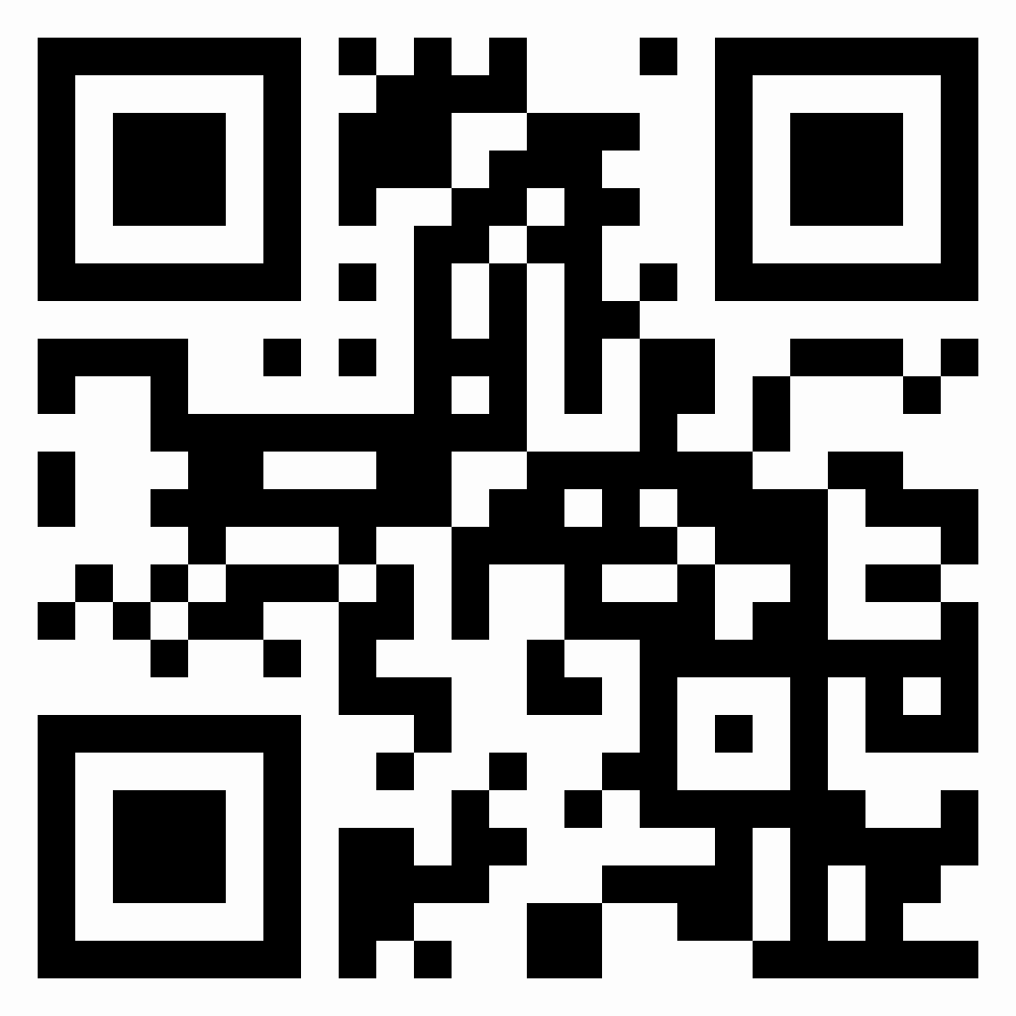
Conclusion
QEP Resources:
www.mecc.edu/qep

