Slide 1
Problem Solving& VALUE Rubric Training: Phase 4
https://www.mecc.edu/qep/
Notes:
Are your classroom colors different than what you see in this template? That’s OK! Click on Design -> Variants (the down arrow) -> Pick the color scheme that works for you!
Feel free to change any “You will…” and “I will…” statements to ensure they align with your classroom procedures and rules!

Slide 2
Introduction
This brief training is an overview of Phase 4 of MECC’s Quality Enhancement Plan.
We appreciate your continued support of MECC’s Quality Enhancement Plan. If we can ever be of assistance, please do not hesitate to let us know.
QEP Co-Chairs:
Bethany Arnold Wes Mullins
barnold@mecc.edu jmullins@mecc.edu

Slide 3
Purpose of the Training
Review the QEP
Provide an overview of Problem Solving in order to best teach it in our classes
Introduce the Problem Solving VALUE Rubric
Discuss embedding and grading the assignment

Slide 4
QEP: What is our QEP?
QEP = Quality Enhancement Plan
The QEP is a required component of our accreditation with SACSCOC
Our QEP is Get AMPED! (Applying Mathematical Principles to Everyday Decisions)
This topic was chosen after review of institutional data that showed that QL and problem solving were areas of need
Get AMPED! implemented in Fall 2020. Phase 1 courses are courses students typically take in their first semester at MECC.
Phase 2 courses are courses students typically take in their second semester at MECC.
Phase 3 courses are courses students typically take in their third semester at MECC.
Phase 4 courses are our capstone courses that students typically take in their last semester: This is our focus for this training

Slide 5
QEP Implementation: Where we are
Our implementation has taken place in phases in order to introduce students to Quantitative Literacy and to apply it through Problem Solving.
Quantitative Literacy has been embedded in at least one course in semesters 1-3 of a student’s degree program.
Problem Solving will be emphasized in the students’ capstone courses.

Slide 6
How do QL and Problem Solving Connect?
“The heart of quantitative literacy is real world problem solving – the use of mathematics in everyday life, on the job, and as an intelligent citizen.” – Henry Pollak, Visiting Professor of Mathematics Education, Teacher’s College, Columbia University
Therefore, QL and Problem Solving are inextricably linked. Our students’ foundation in QL will help them to be effective problem solvers.

Slide 7
What is being asked of you?
In your capstone courses, you will incorporate an assignment that ties together these skills to effectively problem solve.
The assignment has been created for you, and we’ve also created a PowerPoint that you can embed in your courses to introduce Problem Solving to your students. Your main job will be to introduce/expand upon the PowerPoint and to score students’ work using the Problem Solving VALUE Rubric. Information to do both of these is included in this training.
Your To-Do List:
Carefully review this training on Problem Solving
Embed the Problem Solving Introduction for Students in your Capstone Class
Add the Problem Solving assignment in your Capstone Class in Canvas
Score the assignment using the Problem Solving VALUE Rubric in Canvas
The VALUE Rubric will be automatically loaded into your capstone course in Canvas

Slide 8
Problem Solving: A Definition
Problem solving is the process of designing, evaluating and implementing a strategy to answer an open-ended question or achieve a desired goal.

Slide 9
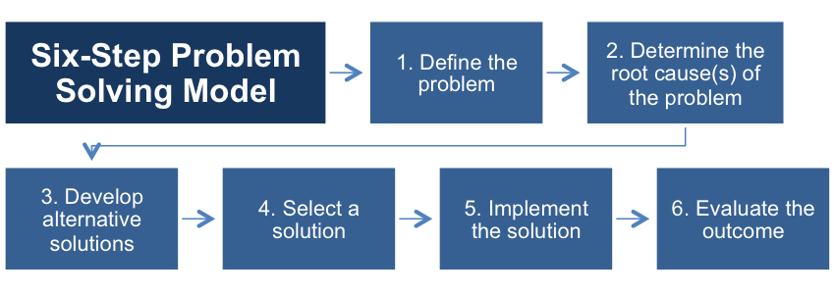
Problem Solving: Introduction
In your capstone courses, you will want to emphasize the below aspects of problem solving, which are further explained on the following slides. We will be providing you with a PowerPoint that you can embed in your classes to introduce these skills to students. The next slides will overview these six steps in more detail.

Slide 10
Step One: Define the Problem
Step One is about diagnosing the problem – the context, background and symptoms of the issue. Once the student has a clear grasp of what the problem is, they investigate the wider symptoms to discover the implications of the problem, who it affects, and how urgent/important it is to resolve the symptoms.
Students should demonstrate the ability to construct a clear and insightful problem statement with evidence of all relevant contextual factors. On the rubric, if students do this well, they would earn a “4” in the second box below. Below is the AAC&U Rubric row corresponding to Defining the Problem.

Slide 11
Step Two: Determine the Root Cause(s) of the Problem
Once the problem is defined, the student begins to explore what has caused the problem. In this step, students may either simply brainstorm on paper or use tools such as the below:
Fishbone diagrams
Pareto analysis
Affinity diagrams
To demonstrate understanding of this, students will need to identify multiple approaches for solving the problem that apply within a specific context. The rubric section for Step two is below:

Slide 12
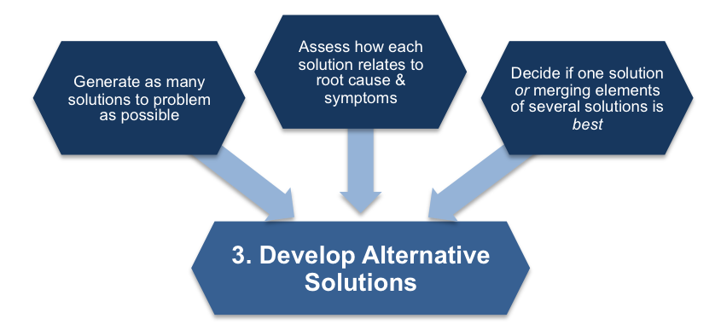
Step Three: Develop Alternative Solutions
Analytical, creative problem solving is about creating a variety of solutions, not just one. Often the most obvious answer is not the most effective solution to the problem. To develop solutions, students will want to focus on:
Proposing one or more solutions/hypotheses that indicates a deep comprehension of the problem. Solution/hypotheses are sensitive to contextual factors as well as all of the following: ethical, logical, and cultural dimensions of the problem.
The corresponding section of the VALUE Rubric is below

Slide 13
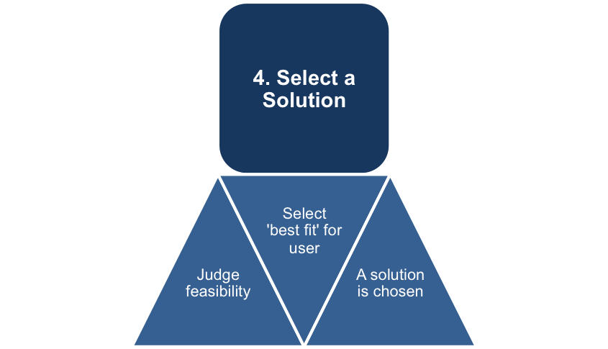
Step Four: Select a Solution
In the fourth step, students provide evaluation of solutions that is deep and elegant (for example, contains thorough and insightful explanation) and includes, deeply and thoroughly, all of the following: considers history of problem, reviews logic/reasoning, examines feasibility of solution, and weighs impacts of solution.
The corresponding VALUE Rubric section is below.

Slide 14
Step Five: Implement the Solution
Once the solution has been chosen, students should consider:
Who is going to implement this solution?
Who else needs to be involved to implement the solution?
What actions need to be taken before implementing the solution
What actions need to be taken during the implementing the solution
Why are these actions necessary?
Therefore, students should implement the solution in a manner that addresses thoroughly and deeply multiple contextual factors of the problem.
Below is the corresponding section of the VALUE Rubric

Slide 15
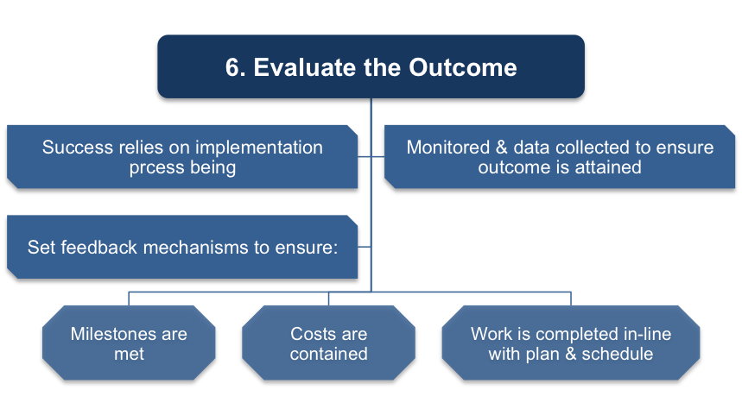
Step Six: Evaluate the Outcome
The project implementation now needs to be evaluated by the students to ensure their recommendations are followed.
Was the proposed solution successful?
What should have been done differently?
What are some possible next steps?
Students should review results relative to the problem defined with
thorough, specific considerations of need for further work.
Below is the corresponding section of the VALUE Rubric.

Slide 16
Six Steps: Summary
Step 1) Define the Problem – Identify problems through problem formulation and questioning. The key is asking the right questions to discover root causes.
Step 2) Determine the Root Cause – During this process, assumptions are uncovered and underlying problems are further revealed. Also, this is an opportunity to collect and analyze data.
Step 3) Develop Alternative Solutions – Decisions are made within the group to determine the appropriate solution and process through creative selection.
Step 4) Select a Solution – Once the group has formed solutions and alternatives to the problem(s), they need to explore the pros and cons of each option through forecasting consequences.
Step 5) Implement the Solution – Develop an action plan to implement and execute the solution process.
Step 6) Evaluate the Outcome – This final stage requires an evaluation of the outcomes and results of the solution process. Ask questions such as: Did the option answer the questions we were working on? Did this process address the findings that came out of the assumptions?
This process helps keep studentstrack, and enables a thorough investigation of the problem and solution search.

Slide 17
AAC&U VALUE Rubrics: Introduction
The Association of American College and Universities’ (AAC&U) Valid Assessment of Learning in Undergraduate Education (VALUE) rubrics are a tool to assess students’ own authentic work across fields of study to determine whether and how well students are meeting specific competencies.
These rubrics were developed by teams of faculty across the nation.
As of December 2015, the rubrics have been accessed by more than 70,000 individuals from more than 5,895 unique institutions, including more than 2,188 colleges and universities.
For the QEP, we are using the Problem Solving VALUE Rubric because it is a valid form of assessment.

Slide 18
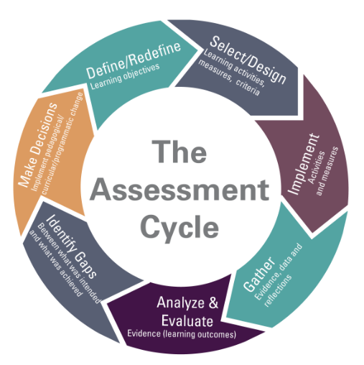
What is a rubric, and why use one?
Rubrics allow us to score student work using a consistent set of standards.
We will be able to compare student scores across semesters and across courses.
Most importantly, we can use what we learn to improve!

Slide 19
Understanding the Rubric: Notes
Be sure to score in whole numbers only
Instructors are encouraged to assign a zero to any work sample or collection of work that does not meet benchmark (cell one) level performance.
The italicized text within each rubric section is only meant to help/provide examples; the student does not have to necessarily meet the specifics of that text.

Slide 20
Canvas Instructions for the Rubric
How to add the rubric to the assignment
Click on the assignment name
Click +Rubric
Scroll to “Mountain Empire”
Add Problem Solving VALUE Rubric
How to Score using the Rubric
Make sure to give a score for each of the six dimensions of the rubric
Hit “Submit” when you are done
You can override the rubric score with a score that fits your grading scale; we can still collect the rubric data
Video and detailed instructions on both of these can be found at www.mecc.edu/qep. The video instructions are for the QL VALUE Rubric, but they are easily applied to the Problem Solving VALUE Rubric. I also attached specific Problem Solving Rubric instructions via email.

Slide 21
How will I implement my Problem Solving Assignment?
You can situate the assignment as you see fit. We would recommend fitting it within an existing unit.
Your assignment does not have to be heavily weighted within your course; it should be weighted, though. You, as the instructor, choose whether this is a high/low stakes assignment in your class.
The assignment should be required, though.

Slide 22
How will I use the Rubric?
You will score your students’ work using the Problem Solving VALUE Rubric that will be embedded in all capstone courses on Canvas.
Instructions on how to do this have been emailed out. They can also be found on www.mecc.edu/qep
If you are not having the students submit their assignment on Canvas, you will need to submit hard copies of the Assignment, the students’ work, and the marked rubrics to Ken Tucker in the division of Arts and Sciences at MECC. The students’ ID numbers should be at the top of their work.
If you are using another digital method of assignment delivery, please send a digital file containing student work and the graded rubrics to ktucker@mecc.edu.

Slide 23
What’s next?
In Summer 2023 (and each summer after until 2025), we will analyze all problem solving assignment performance data for all capstone classes.
Out of the courses selected each year, we will randomly select student work for Holistic Grading.
This student work will be scored by the Holistic Grading Team, whose membership will rotate yearly.
The purpose of the Holistic Grading is to ensure consistency in grading.
The HGT will score student work and then compare the scores to the instructor’s scores (inter-rater reliability).
If there is a large difference in the way that the HGT scores and the way that the instructor scored, further instructor training on rubrics will be provided, or we will look at rubric wording/phrasing/applicability.

Slide 24
What’s next?
You will implement your Problem Solving assignment in Spring 2023
All courses will utilize the same assignment. This assignment can be found on www.mecc.edu/qep. It is the “Phase 4 Problem Solving Assignment.”
Please be sure to allot time in your Spring 2023 calendar for your assignment and for related instruction.
You will continue to utilize this assignment in your capstone course through Summer 2025.

Slide 25
Thank you!
Thank you so much for your commitment to this Quality Enhancement Plan. If you have any questions, please email.
QEP Co-Chairs:
Bethany Arnold Wes Mullins
barnold@mecc.edu jmullins@mecc.edu
Have a wonderful school year!

